Slide 1
Module 2: front end development framework & tools
TITLE : VIDEO CONFERENCING

Slide 2
TOPICS COVERED
Video Conferencing Architecture
Modules
Html structure
CSS
Javascript
Bootstrap
jQuery-ajax-promises
API Integration

Slide 3
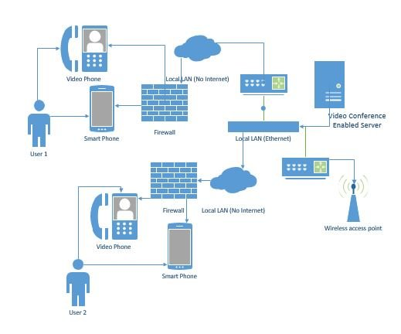
Video Conferencing Architecture

Slide 4
video conferencing architecture which supports server-side data processing. Upon gathering primary video streams from all the endpoints, the server separately performs the following actions for each endpoint:
Combines thumbnail videos of the participants in a single video stream with the layout requested by the endpoint.
Encodes the video stream up to the quality that meets
bandwidth from the MCU to the specific endpoint at the given moment.
3. Sends a video stream to the endpoint.

Slide 5
Modules
Webcam: A high-quality webcam is essential for capturing and transmitting video.
Microphone: A good quality microphone ensures clear and crisp audio.
Speaker or Headset: For listening to audio during the conference. Headsets are useful for reducing background noise.
Computer or Mobile Device: The device you use to run the video conferencing software.
Internet Connection: A stable and reasonably fast internet connection is crucial for smooth video and audio transmission.
Display/Screen: To view the video feed of participants.

Slide 6
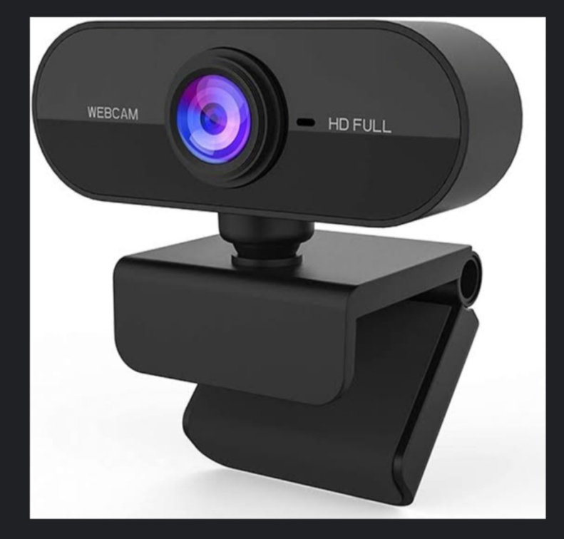
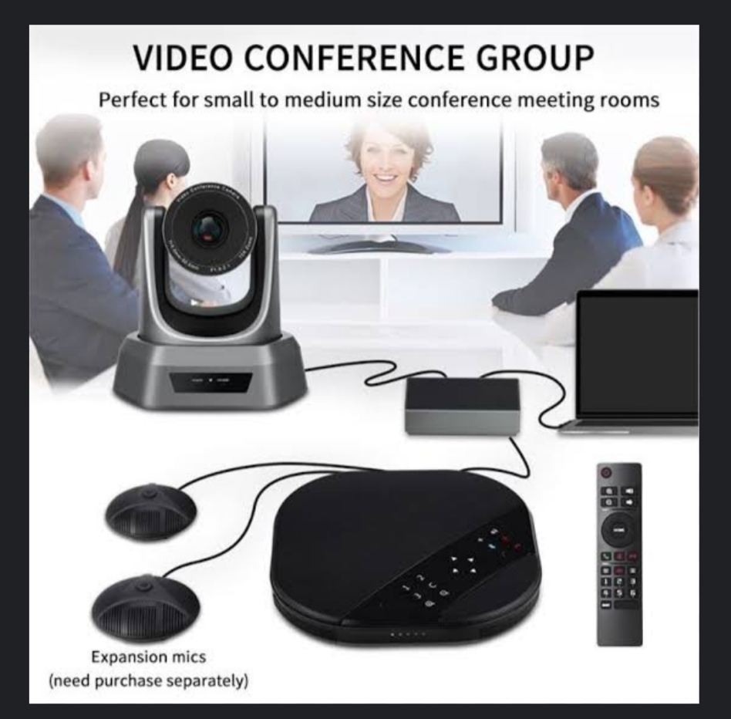
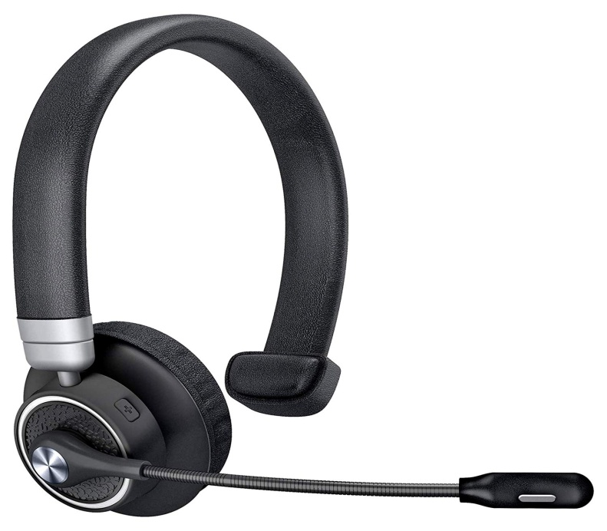

Slide 7
HTML STRUCTURE
<!DOCTYPE html>
<html>
<head>
<meta charset="UTF-8">
<title>Video Conferencing</title>
<link rel="stylesheet" href="styles.css">
</head>
<body>
<header>
<h1>Video Conferencing</h1>
</header>

Slide 8
<main>
<div id="local-video">
</div>
<div id="remote-videos">
</div>
</main>
<footer>
<button id="start-button">Start</button>
<button id="stop-button">Stop</button>
</footer>
<script src="app.js"></script>
</body>
</html>

Slide 9
CASCADIND STYLE SHEET
CSS (Cascading Style Sheets) is used to control the presentation and layout of HTML documents.
It allows you to define styles for elements on a web page, including their appearance, positioning, and behavior.
CSS includes additional styles for video labels, video grid layout, user status indicators, and a participant list.

Slide 10
JAVASCRIPT
JavaScript is a versatile programming language used for adding interactivity and functionality to web pages.
It allows developers to add interactivity and dynamic behavior to websites, making them more engaging and responsive to user actions.
Syntax
try {
// Code that may throw an error
} catch (error){
// Handle the error }

Slide 11
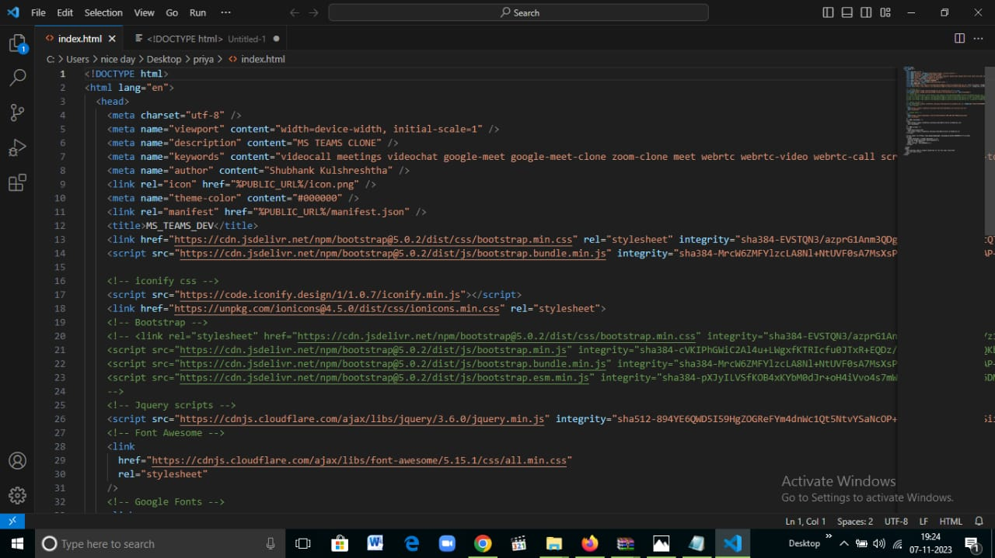

Slide 12
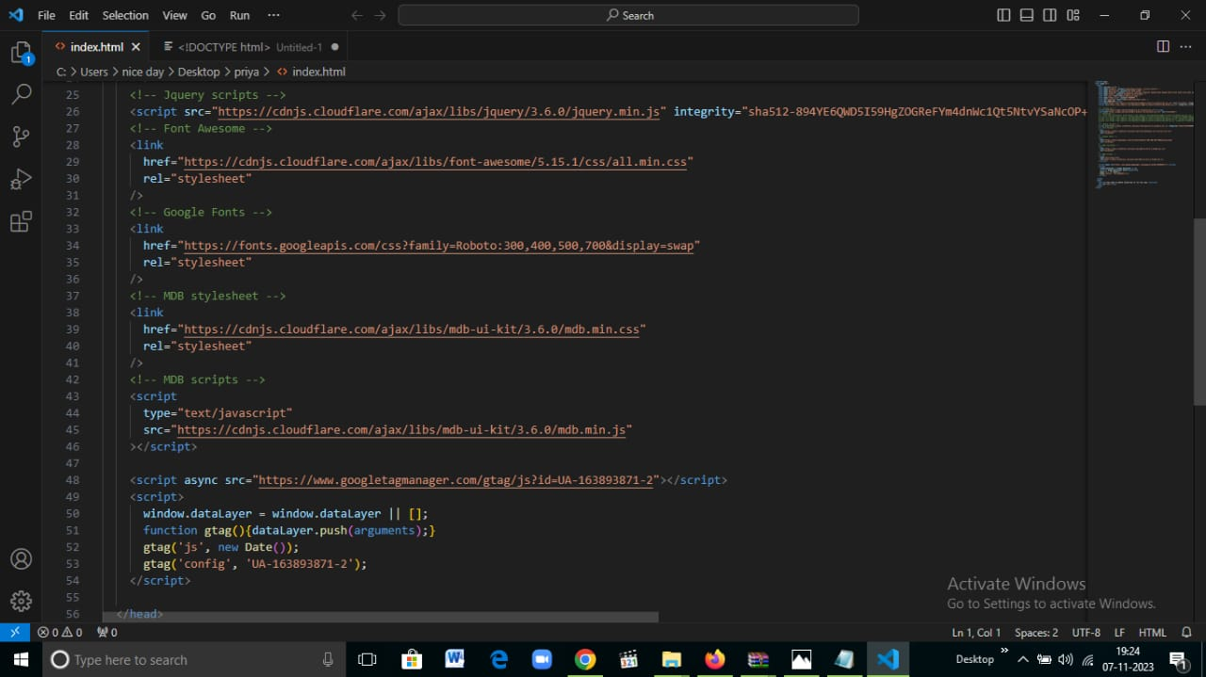

Slide 13
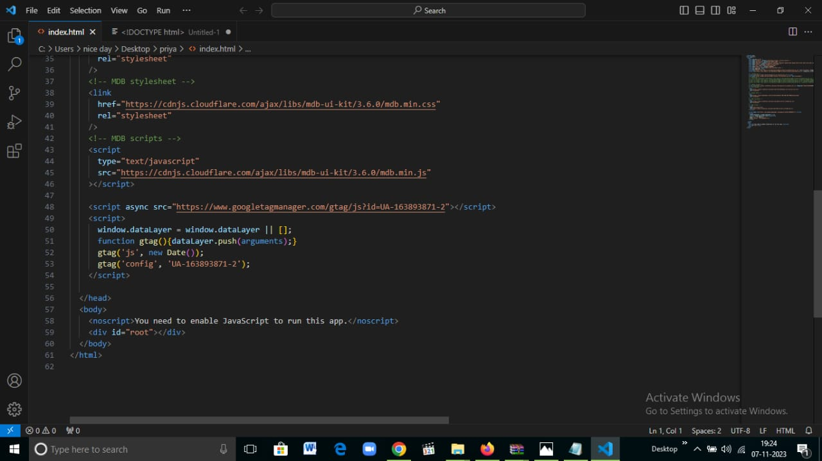

Slide 14
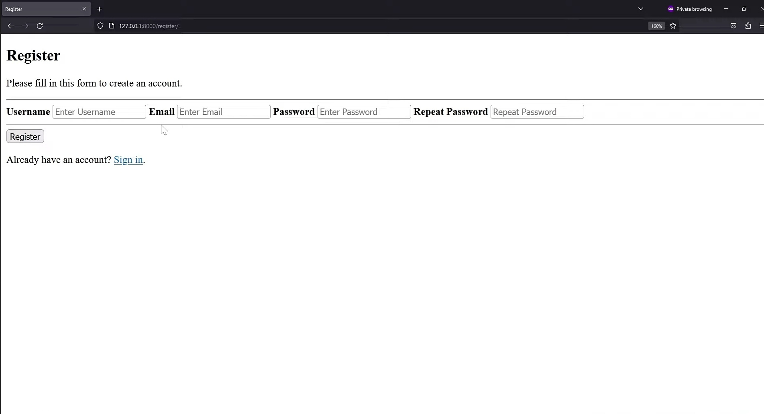

Slide 15
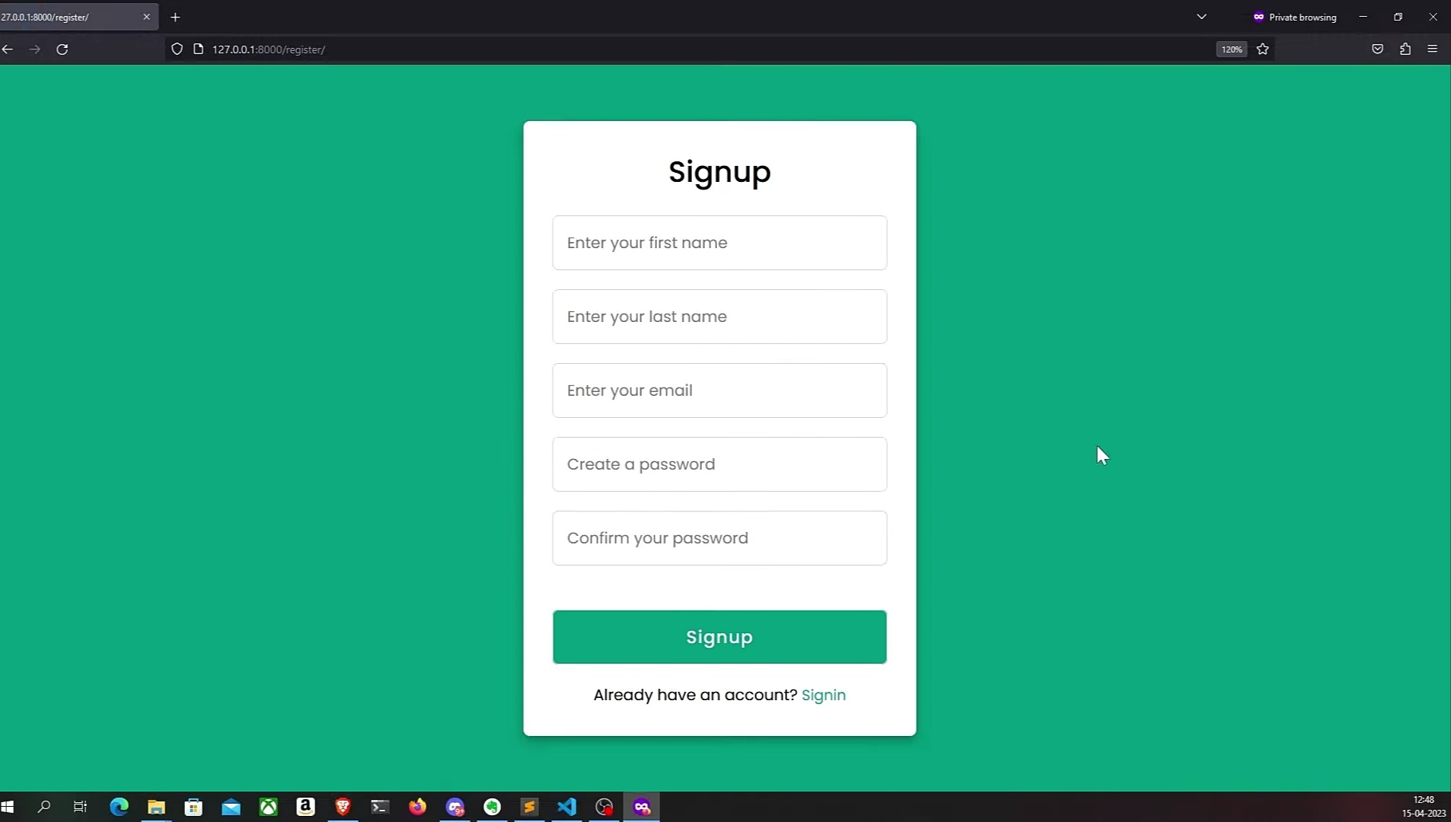

Slide 16
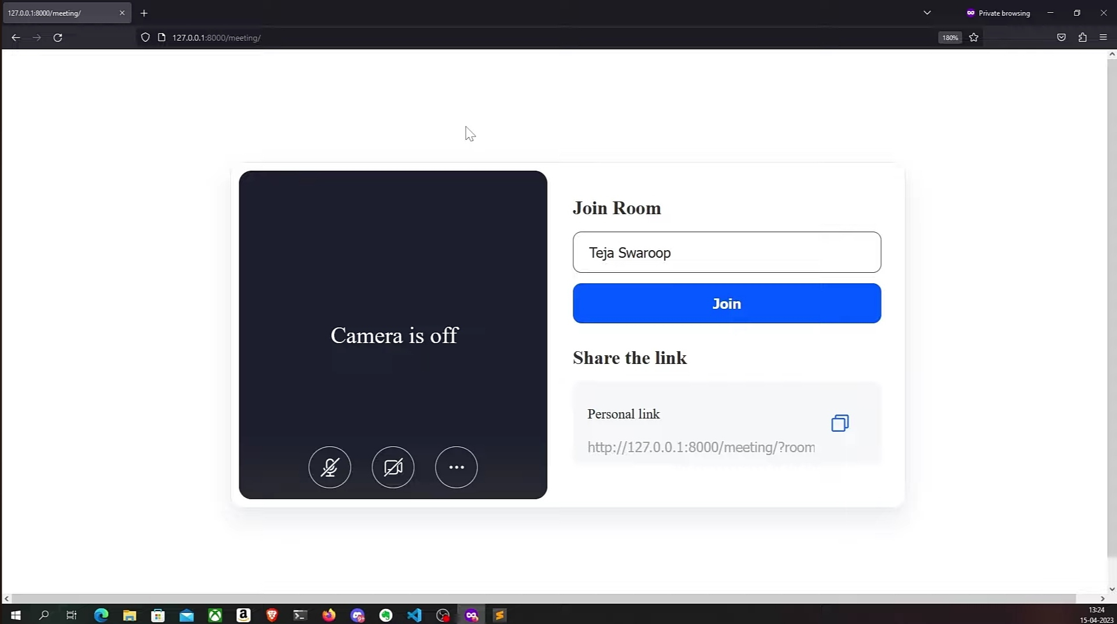

Slide 17
BOOTSTRAP
Bootstrap is a popular open-source front-end framework for web development.
It provides a set of pre-designed, responsive, and customizable HTML, CSS, and JavaScript components and styles, making it easier for developers to create modern, mobile-friendly web applications and websites.

Slide 18
BOOTSTRAP STRUCTURE
<!DOCTYPE html>
<html>
<head>
<meta charset="UTF-8">
<title>My Bootstrap Website</title>
<linkrel="stylesheet"href="https://cdn.jsdelivr.net/npm/bootstrap@5.5.0/dist/css/bootstrap.min.css">
</head>
<body>
<div class="container">
<h1>Hello, Bootstrap!</h1>
<button class="btn btn-primary">Click me</button>
</div>
<scriptsrc="https://cdn.jsdelivr.net/npm/bootstrap@5.5.0/dist/js/bootstrap.min.js">
</script>
</body>
</html>

Slide 19
JQUERY-AJAX- PROMISES
jQuery is a JavaScript library that provides various utilities and functions to simplify working with web technologies.
One of its popular features is making AJAX (Asynchronous JavaScript and XML) requests, which allow you to communicate with a server without requiring a full page refresh.
jQuery uses the Deferred and Promise objects to handle asynchronous operations, and you can work with promises to manage the outcomes of your AJAX requests.

Slide 20
API INTEGRATION
Integrating an API into a video conferencing application can enhance its functionality and allow you to leverage external services or data.
video conferencing, you might consider APIs like WebRTC, Zoom, Microsoft Teams, Google Meet, or other video conferencing service APIs. The choice will depend on your specific requirements, such as scalability, features, and platform compatibility.
video conferencing API requires user authentication, you'll need to implement a login system that securely authenticates users and manages access to the API.

